Slide 1
Text Analytics
Module 3: Semantic Processing

Slide 2
Text Analytics Stack
Meaning
Machine
Translation
Semantic Processing
General knowledge Domain Knowledge
Discourse Context
Question
Answering
Syntactic Processing
Conversational
UI
Language
Tokenization and Shallow Parsing
Lexical Processing
Text
(User Generated Content)

Slide 3
Semantics Essentials

Slide 4

Terms vs Concepts
Terms are “linguistic handles” to concepts -- which are latent
Some concepts have a physical or sensory experience associated with it, while there are several concepts that are purely latent
Examples of sensory concepts:
cat, horse, house, sour, thunder, soft
Examples of latent concepts:
ownership, tenancy, sovereignty, freedom, compassion
cat
katze
ಬೆಕ್ಕು
बिल्ली
貓

Slide 5
Terms vs Concepts
Terms are linguistic “handles” to concepts that are purely abstract
Ordinary Language Philosophy (OLP)
Association of terms to concepts is not static, and emerges by use
Example: “Awful” and “Artificial” as compliments
Distributional Hypothesis
Terms having similar meanings tend to appear in similar contexts
Guess the meaning of the term greebel in the below paragraph:
“Everyday, I go to work in a greebel. There are two options for me. The 8:15 slow greebel takes 45 minutes, while the 8:30 fast greebel takes me to work in 30 minutes. If I miss both, I can take the purple line greebel at 8:40, but will need to change twice before reaching office, an hour later.”

Slide 6
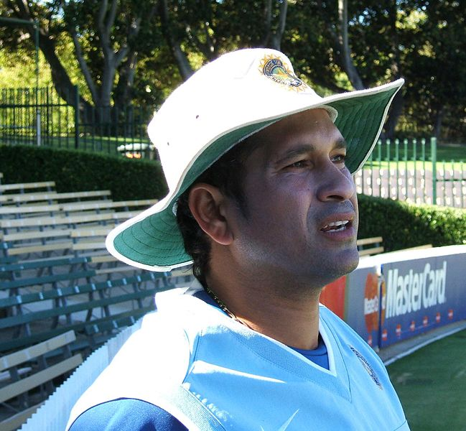
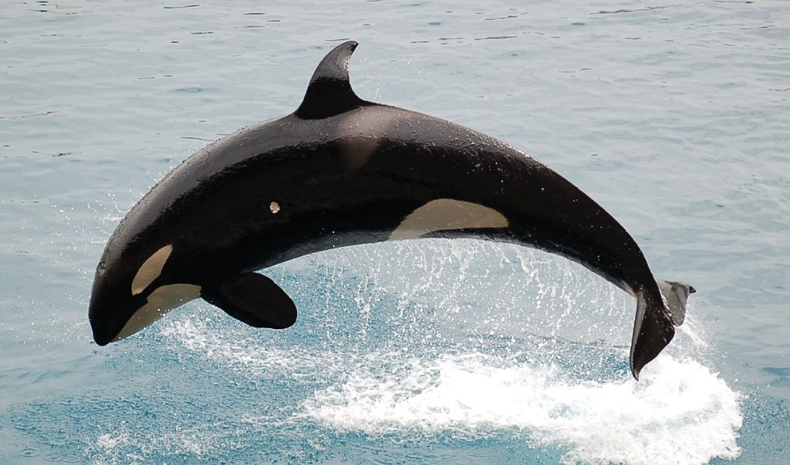
Concepts, Entity Types and Entities
Concepts are abstractions that exist “simpliciter” and that form the basis on which semantics are constructed
Concepts that can be “instantiated” -- that is, whose manifestation can be found in the physical world, are called “Entity types”
Instances of entity types that exist in the physical world, are called “Entities”
Animal
Mammal
Human Whale
Sachin Billy
Conceptual world
Physical world
Acknowledgment: Images sourced from Google Image search

Slide 7
Semantic Associations
Reports
to
Semantic associations are represented as a “predicate” or a “relationship type” that relates one or more “entity types”
The number of entity types participating in a relationship type is called the “arity” of the relationship type. Arity 1 are called unary relationships, and arity 2 are called binary relationships
Note that arity of a relationship type and that of a relationship instance, may be different
In Fig (a), the relationship type has arity 1, while its instances have arity 2.
(a)
(b)
Employee
Supplier
Procurement
Component
Project

Slide 8
Semantic Associations
Relationship types can be represented as “Predicates” of first order logic:
The diagram on the right becomes the following predicate:
Procurement(s,c,p)
where s, c, and p are “free variables” over the domains: (set of all) Suppliers, Components, and Project, respectively
Supplier
Procurement
Component
Project

Slide 9
Semantic Associations
Higher arity associations carry more “meaning” and cannot always be broken down to associations with lower arity
Figure shows a ternary relation of the form:
Teaching(t,c,s)
“Teacher t teaches course c, in semester s”
Suppose this were broken down into three binary predicates, which (say) are all true:
TeachesIn(t,s), InstructorOf(c,t), Offers(s,c)
“Teacher t teaches in semester s, Teacher t is the instructor of course c, Course c is offered in semester s”
teachesIn
Teacher
InstructorOf
Teaching
Semester
Offers
Course
Even if all three binary associations are true, it does not imply the existence of the ternary association instance!

Slide 10
Semantic Associations
While higher-order associations carry more semantics than lower-order associations, the number of higher order associations can be extremely high
Given a set of N entity types, the total number of possible arity is given by 2^{N} -- or the power set of all entity types
For practical semantic processing, we usually work with a maximum arity of 2. Higher order semantics are represented by means of reification.
RDF
Open W3C standard for representing semantic assertions. Forms the basic building block of Linked Open Data (Semantic Web). Represents binary associations in the form of triples:
(subject, predicate, object)
NQuad
Open W3C standard for representing contextualized semantic assertions. Represents binary association along with a context (RDF graph) where this association holds:
(subject, predicate, object, context)

Slide 11
Semantic Associations
Teacher
Reification
Representation of a complex set of associations or phenomena, as an instance of an abstract entity type. Often takes the form of a #hashtag on social media.
Example: #Brexit represents a reified, conceptual entity that captures myriad associations and phenomena about an issue concerning Britain and EU.
Reification helps to reduce complexity of managing higher-order relationships.
An n-ary relationship can be reduced to a collection of n binary relationships with a new reified entity.
Teaching
Semester
Course
Teacher
Teaching
Roster
Semester
Course

Slide 12
Semantic Associations
While associations can have any kind of semantics, some associations are very commonly found, and characterized separately:
IS-A
Represents a superclass-subclass relationship. Also called “is a kind of”, “is a type of”. The relationship
“B is-a A”
Implies:
Every B is a type of A. The set of all instances of A is a superset of the set of all instances of B. The set of all characteristic properties of B is a superset of the set of all characteristic properties of A. An instance of B can be used wherever we need an instance of A.
IS-IN
Represents a container-part relationship. Also called “is contained in”, “is a part of”. The relationship
“B is-in A”
Implies:
If A is inaccessible (due to physical or normative reasons), then so is B.
If A is destroyed/deleted, then so is B.
Ownership of A implies ownership of B.

Slide 13
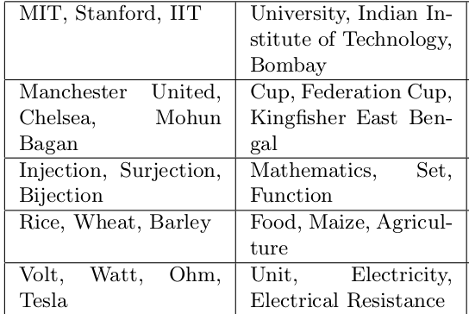
Aboutness
“Relevance” relationship between a group of concepts and another concept (or set of concepts)
Example:
{insulin, hypertension, blood sugar} are collectively “about” diabetes
(and also about several other concepts, including “English words”)
Aboutness represents a graded “topic” relationship between a concept and a set of other concepts.

Slide 14
Terms and Concepts
Association between terms and concepts are established by use, and evolves over time.
Hypernyms and Hyponyms
Given two terms u and v, u is said to be a hypernym of v (and v a hyponym of u) if u represents a more generalized concept of v.
Example: “animal” and “cat”
Antonyms
Two terms u and v are said to be antonyms of one another if they represent concepts that have mutually opposing characteristics.
Example: “hot” and “cold”
Meronyms and Holonyms
Given two terms u and v, u is said to be a holonym of v (and v a meronym of u) if there is a “part-of” relationship between u and v.
Example: “car” and “engine”
Synonyms
Disparate terms that represent the same (or very similar) concepts. Example: “Sidewalk” and “Footpath”
Homonymy and Polysemy
If a word represents two are more unrelated concepts, it is called homonymy. If the senses are related, it is called polysemy. Example: duck (the bird, to bend down, zero)

Slide 15
Terms and Concepts
Principle of Compositionality and its violations
When two words representing specific concepts are combined, in the sense of their concepts, the combined phrase may or may not represent the composition of the constituent concepts.
Compositionality retained:
Red ball, heavy bag, round cake
Compositionality violated:
Red handed, heavy duty, round table
Collocations
Collocations represent phrases, where the combined meaning is the sum of the meaning of its constituent parts, plus an extra dimension that cannot be predicted from the meaning of the parts.

Slide 16
WordNet
A lexical database for English, useful for semantic processing
Groups words into cognitive synonyms called synsets, each representing a different concept
Synsets interlinked by means of conceptual and lexical relations
Most widely encoded relations include hypernymy-hyponymy, meronymy-holonymy
Interlinks not just words -- but also their senses
https://wordnet.princeton.edu/
Synset graph freely available for download
Both nouns and verbs organized using the hypernym hierarchy

Slide 17
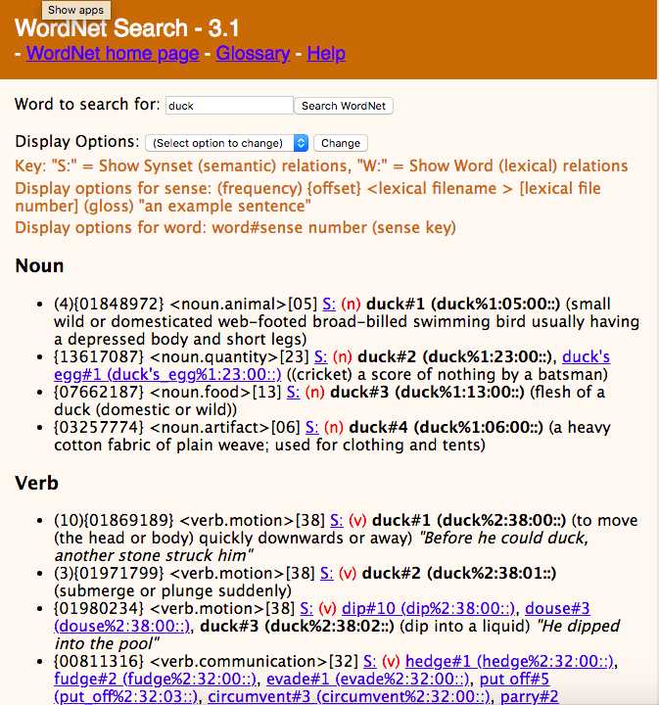
WordNet
As of Nov 2012, WordNet database contains 155,327 words organized in 175,979 synsets
Includes lexical categories of nouns, verbs, adjectives and adverbs
Synsets comprise of roughly synonymous words belonging to the same lexical category
Different senses of a word grouped into different synsets, and identified by a sense hash (Example: duck#1, duck#2, etc.)

Slide 18
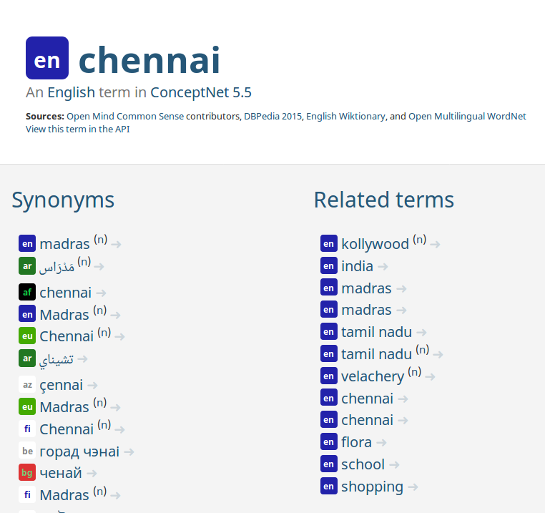
ConceptNet
Disambiguation using ConceptNet
ConceptNet.io http://conceptnet.io/ -- a freely available “common sense” semantic network characterizing meanings of words and relationships between them
Originated from the MIT OpenMind Commonsense, crowdsourcing project
Provides several semantic properties like: Synonyms, Related terms, Part-of, Type-of, etc.

Slide 19
Word Sense Disambiguation
Given the fluid nature of association between terms and concepts, we often need to “disambiguate” the “sense” in which a given word is used in a context.
Example: The batsman had to duck in order to avoid a duck that was flying too low, because of which, he was out for a duck.
Supervised WSD algorithms
Assumes senses of a word to be tagged by a “context” or “sense” label, in a training dataset.
The batsman had to duck/bend in order to avoid a duck/bird that was flying too low, because of which, he was out for a duck/zero.
Assigns sense labels by maximizing posterior probabilities
Unsupervised WSD algorithms
Requires no sense label or training data. Clusters words of similar senses into a single cluster in an unsupervised fashion.

Slide 20

Word Sense Disambiguation
WSD using a Naive Bayes Classifier
Given: a training dataset with words assigned different senses from a set of sense labels S
Posterior probability of sense s_{k} for word w is given by:
Dropping the denominator (since it is constant across all senses) and computing the log probabilities (to prevent underflow), sense assignment is computed as:
Supervised Naive Bayes classifier works on a bag-of-words assumption -- ignoring co-occurring words in the context of a given word, to resolve the sense.

Slide 21
Word Sense Disambiguation
LESK algorithm
Unsupervised WSD algorithm based on comparing dictionary definitions of the word and its neighbouring words.
Implemented in NLTK
In the example, terms Bank and Fish would be assigned to their first sense (Bank#1, Fish#1) given common terms in their definition (water).
“A stork stood on the bank looking at the fish”
Bank:
The land alongside or sloping down to a body of water.
A financial institution
A long, high mass or mound of a particular substance.
Fish:
A limbless cold-blooded vertebrate animal with gills and fins living wholly in water.
Search by groping or feeling for something concealed.

Slide 22
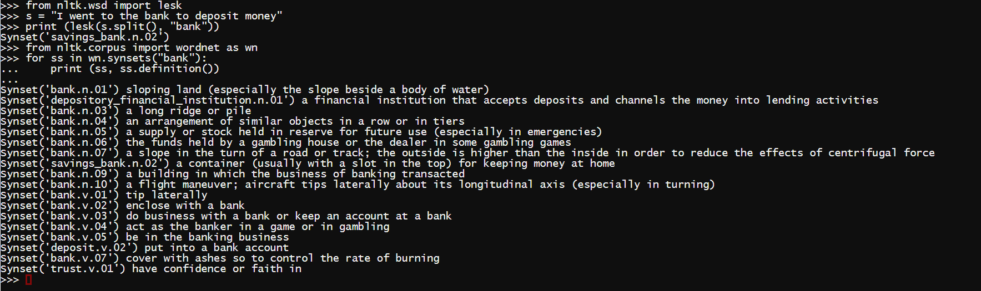
Word Sense Disambiguation
LESK algorithm in NLTK

Slide 23
Distributional Semantics

Slide 24
Distributional Semantics
Characterizing the semantics of terms based on its usage.
Basis for Ordinary Language Philosophy (OLP)
“A word is characterized by the company it keeps”
“Words with similar meanings tend to be used in similar contexts.”
Guess the meaning of the term greebel in the below paragraph:
“Everyday, I go to work in a greebel. There are two options for me. The 8:15 slow greebel takes 45 minutes, while the 8:30 fast greebel takes me to work in 30 minutes. If I miss both, I can take the purple line greebel at 8:40, but will need to change twice before reaching office, an hour later.”

Slide 25
Distributional Semantics
Characterizing the neighbourhood of words
Distribution over Occurrence Contexts
Represented as a rectangular term x context (document) matrix
Rows represent term vectors while columns represent context vectors
Example: LSA
Distribution over Co-occurrence of terms
Represented as a square matrix showing co-occurrence between terms in different occurrence contexts
Also called Syntagmatic Distributional Semantics
Example: HAL, Word2vec, GloVe

Slide 26
Distributional Semantics
Occurrence Matrix
C₁ C₂ C₃ C₄ C₅ …. …. C_{n}
t₁
t₂
t₃
t₄
t₅
...
f_{1,1} f_{1,2} f_{1,3} f_{1,4} f_{1,5} …. …. f_{1,n}
f_{2,1} f_{2,2} f_{2,3} f_{2,4} f_{2,5} …. …. f_{2,n}
….
….
….
Term distributional vector
Example occurrence contexts:
Sentence
Paragraph
Tweet
Comment
Context / document distributional vector

Slide 27
Distributional Semantics
Co-occurrence Matrix
A square matrix C_{m,m} where m is the number of terms in the corpus, depicting the co-occurrence of terms
Basic model of capturing co-occurrence frequency results in a symmetric matrix
Variants like conditional probability of co-occurrence, results in non-symmetric matrix
Capturing co-occurrence
Occurrence context
Divide the corpus into occurrence contexts. A pair of terms said to co-occur if they occur in the same context
Skip-grams
A k-skip-N-gram is a sequence of N (not necessarily consecutive) words where the distance between any two words is at most k.
Generate all skip-grams from the corpus using a sliding window over the text stream. A pair of terms are said to co-occur if they appear in the same skip-gram.

Slide 28
Distributional Semantics
 | fly | sitting | wall | cat | fence
fly | 1 | 1 | 1 | 0 | 0
sitting | 1 | 1 | 1 | 1 | 1
wall | 1 | 1 | 1 | 0 | 0
cat | 0 | 1 | 0 | 1 | 1
fence | 0 | 1 | 0 | 1 | 1
Input text
There is a fly sitting on the wall. The cat is sitting on the fence.
3-skip-2-grams
fly sitting, sitting wall, wall cat, cat sitting, sitting fence
Context co-occurrence
 | fly | sitting | wall | cat | fence
fly | 1 | 1 | 0 | 0 | 0
sitting | 1 | 1 | 1 | 1 | 1
wall | 0 | 1 | 1 | 1 | 0
cat | 0 | 1 | 0 | 1 | 0
fence | 0 | 1 | 0 | 0 | 1
skip-gram co-occurrence

Slide 29




Distributional Semantics
Distributional incidence Matrix
Distributional frequency Matrix
Distributional Relevancy Matrix (tf-idf)
where
|C| is the number of occurrence contexts and |C_{ti}| is the number of contexts where t_{i} has occurred.
Idf can be seen as the self information (uniqueness, surprisal) of a term appearing in any context

Slide 30
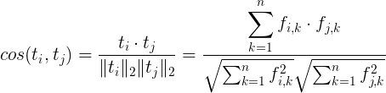

Distributional Semantics
Comparing Word Vectors
L_{p} Norm
Given t_{i} = (f_{i,1}, f_{i,2}, …, f_{i,n}) and t_{j} = (f_{j,1}, f_{j,2}, …, f_{j,n})
p=1: Manhattan distance
p=2: Eucledian distance
Cosine similarity
Since distributional values are all non-negative, cosine similarity values range between 0 and 1.

Slide 31
Word Embeddings
Raw matrix (either term-document or term co-occurrence) too noisy due to following factors:
Spurious terms increasing dimensionality
Correlations between dimensions
Sparse matrices
Word embedding is a process of mapping words (terms) to a (typically smaller dimension) vector space that preserves their distributional semantics
HD raw vectors
(millions of dimensions)
LD word embeddings
(hundreds of dimensions)
SVD /
PCA /
CBOW /
Skipgrams

Slide 32
Word Embeddings
Two broad types of approaches to compute word vectors:
Frequency based approaches
Prediction based approaches
Frequency based embedding models
Dimensionality reduction over term-context incidence matrix using matrix factorization techniques like eigendecomposition and SVD
Prediction based embedding models
Maximizes probability of generation of terms given occurrence contexts. Examples: Skip-grams, CBOW

Slide 33
Word Embeddings using SVD
Latent Semantic Analysis (LSA)
Given a term-context matrix A of size m x n depicting occurrence frequencies of terms across different contexts, factorize the matrix as follows:
Where r is the rank of matrix A.
The matrix U represents the r dominant eigenvectors of A A^{T}
The matrix V represents the r dominant eigenvectors of A^{T}A
∑ is a diagonal matrix represent the r non-zero singular values of A, computed as the square roots of the non-zero eigenvalues of A^{T}A and AA^{T}.

Slide 34
Word Embeddings using SVD
Latent Semantic Analysis (LSA) uses SVD to decompose a term-context matrix to a rank-k approximation
That is, only retain the top k singular values and the corresponding eigenvectors from U and V^{T} to compute the lower dimensional factorization:
Rows of U now represent term embeddings in k-dimensional space
Rows of V^{T} now represent context (document) embeddings in k-dimensional space

Slide 35
Word2Vec
Word Embeddings using Skipgrams
Prediction based embedding models based on maximizing the probability of generation of a term given a surrounding context or vice versa.
Ex: “what will be will be”
Skipgrams training sets:
([will], what), ([what, be], will), ([will,will], be), ([will], be)
Skipgrams
Input matrix
V x N
Output matrix
V x N
what
will
N
be
V
V

Slide 36

Word2vec
Skipgram based embeddings are based on predicting the co-occurrence context, given a word
Embeddings computed by training a shallow neural network with a single hidden layer of N neurons (dimensionality of the word vector), with one input layer of size V providing inputs as 1-hot vectors, and training outputs as c 1-hot vectors, where c is the window size.
The input word is typically in the middle of the context with c/2 words in either direction.
Objective function: maximize the average log probability of the context, given a word
Where w^{c}_{i} is the context around word w_{i}, and w^{c} is the set of all contexts for all words in the vocabulary

Slide 37
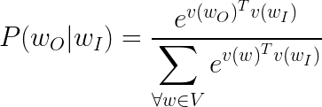
Distributional Semantics
Word Embeddings using Skipgrams
Example sentence:
I think, therefore I am
Training samples (with c=2):
(I, think) (think, I) (think, therefore)
(therefore, think) (therefore, I)
(I, therefore), (I, am)
P(w^{c}_{i}|w_{i}) is modeled as a softmax function over the input and output word vectors v(w_{O}) and v(w_{I}) averaged over all words in the vocabulary:

Slide 38
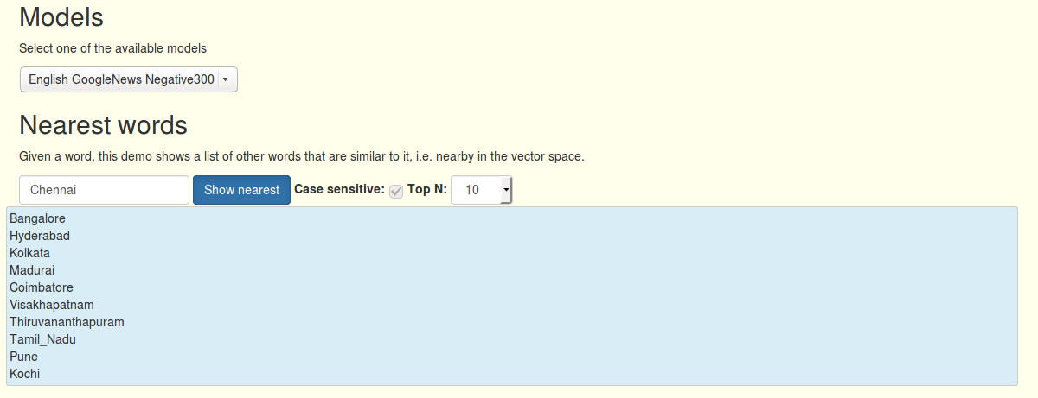
Word2vec demo
Demo source: http://bionlp-www.utu.fi/wv_demo/

Slide 39
Topic Modeling

Slide 40
Topic
Represents the semantic “aboutness” of a set of concepts
A given concept is relevant to (“is about”) several concepts. But given a set of concepts, they are collectively “about” a smaller set of other concepts (topics).
A given document may be about several topics with varying levels of importance. For example: a document that is “about” Sachin Tendulkar, may also talk “about” Mumbai, “about” Rajya Sabha, etc. to various levels.
Sweets Molasses
Diabetes Insulin
Sugar Carrot
Sucrose Glucose Hypertension
Hydrocarbon Blood pressure Music

Slide 41
Topic Model
Generative stochastic model representing the distribution of topics in a document and terms in a topic
Topic modeling represented as a problem of estimating the parameters of the generative model
Example Topic Models
Probabilistic Latent Semantic Analysis
Latent Dirichlet Allocation
Explicit Semantic Analysis

Slide 42

Topic Model: ESA
Explicit Semantic Analysis (ESA) is a variant of the term-document matrix in the following ways:
Term vectors represent the tf-idf distribution over documents
Documents are represented as centroids of all terms that occur in them
Topical relatedness between documents u,v measured using cosine similarity:
d₁ d₂ d₃ d₄ d₅ …. …. d_{n}
t₁
t₂
t₃
t₄
t₅
...
f_{1,1} f_{1,2} f_{1,3} f_{1,4} f_{1,5} …. …. f_{1,n}
f_{2,1} f_{2,2} f_{2,3} f_{2,4} f_{2,5} …. …. f_{2,n}
….
….
….

Slide 43
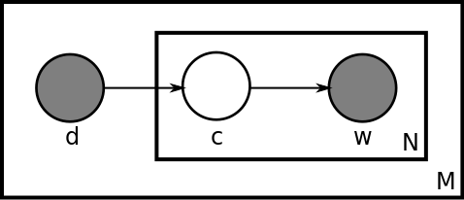

Topic Model: PLSA
Models a document as a distribution over topics, and a topic as a distribution over terms. While document (d) and word (w) are observable variables, topic (c) is latent.
Called the “aspect” model for latent semantics.
Joint probability of a word occurring in a document P(w,d) is given by:
The number of topics is a “hyperparameter” specified at the start of the computation.
Plate notation for the latent class mixture model of PLSA
Image source: By Bkkbrad, EduardoValle - http://en.wikipedia.org/wiki/File:Plsi.svg, CC BY-SA 3.0, https://commons.wikimedia.org/w/index.php?curid=25295245

Slide 44

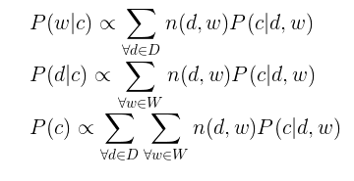
Topic Model: PLSA
Given a collection of documents D, a vocabulary of terms W that occur in D, and a set of latent topics C, where |C| = k:
PLSA tries to maximize the posterior probability P(c|d,w) using Expectation Maximization (EM) algorithm.
E-step calculation:
M-step calculations:

Slide 45
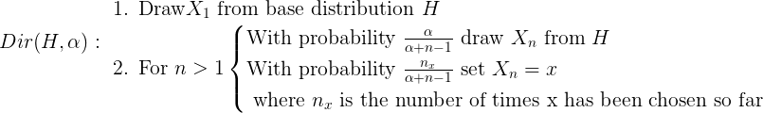
Topic Model: LDA
Latent Dirichlet Allocation (LDA) has an identical latent topics model as that of PLSA. However, it assumes a sparse Dirichlet prior for the distribution of topics P(c)
Helps in disambiguating terms with polysemy and homonymy
PLSA can be seen as a special case of LDA with uniform distributions for priors.
Dirichlet Process: Models a “rich-get-richer” stochastic process resulting in a set of distributions around a “base” distribution H.
Random variable X can take on k possible values, with an initial base distribution H. Subsequent draws will be affected not just by H, but also the number of times a particular value has already been chosen.
Related processes: Polya’s Urn, Chinese restaurant process

Slide 46
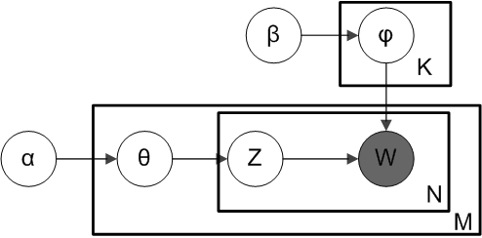
Topic Model: LDA
Elements of an LDA process:
α : Parameter for Dirichlet prior on per-document topic distribution
β : Parameter for Dirichlet prior on per-topic word distribution
θ_{m} : Topic distribution for document m
φ_{k} : Word distribution for topic k
z_{mn} : Topic for the n^{th} word in document m
w_{mn} : n^{th} word in document m
Plate notation for LDA
By Slxu.public - Own work, CC BY-SA 3.0, https://commons.wikimedia.org/w/index.php?curid=7922733

Slide 47
Topic Model: LDA
A | d₁ | d₂ | d₃
w₁ | n(d₁,w₁) | n(d₂,w₁) | n(d₃,w₁)
w₂ | n(d₁,w₂) | n(d₂,w₂) | n(d₃,w₂)
Input:
Document corpus as a term-document matrix A_{m x n}
Outputs:
Document-topic matrix: C_{n x k}
Topic-term matrix: W_{k x m}
C | c₁ | c₂ | c₃
d₁ | P(d₁|c₁) | P(d₁|c₂) | P(d₁|c₃)
d₂ | P(d₂|c₁) | P(d₂|c₂) | P(d₂|c₃)
W | w₁ | w₂ | w₃
c₁ | P(w₁|c₁) | P(w₂|c₁) | P(w₃|c₁)
c₂ | P(w₁|c₂) | P(w₂|c₂) | P(w₃|c₂)

Slide 48
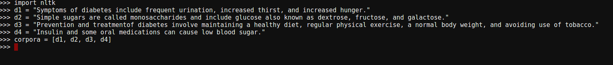
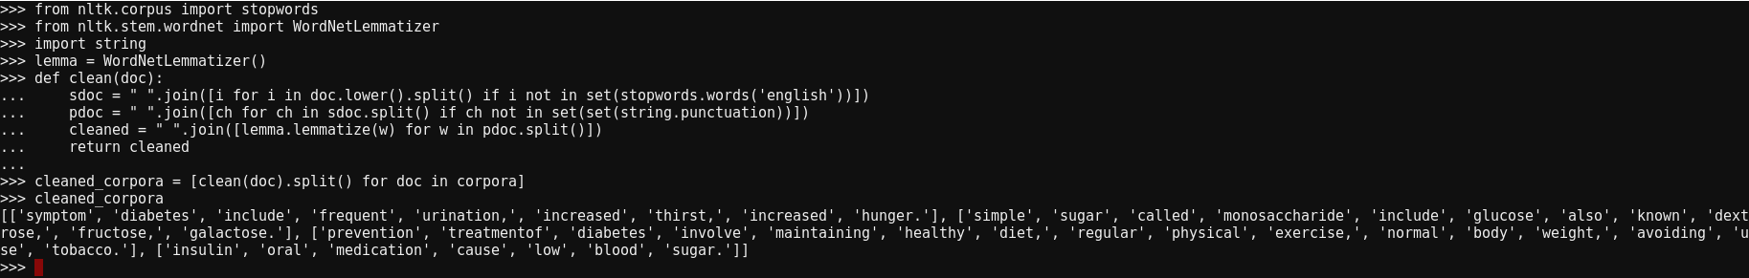
Topic Model: LDA
Create a sample corpora
Clean the data by removing stopwords, punctuation, and lemmatizing the words

Slide 49

Topic Model: LDA
Create a term-document matrix using the gensim Dictionary class
Run LDA using the gensim LdaModel class. Hyperparameter k specified as num_topics
Acknowledgment: LDA example adapted from https://www.analyticsvidhya.com/blog/2016/08/beginners-guide-to-topic-modeling-in-python/

Slide 50
Generative NLP

Slide 51
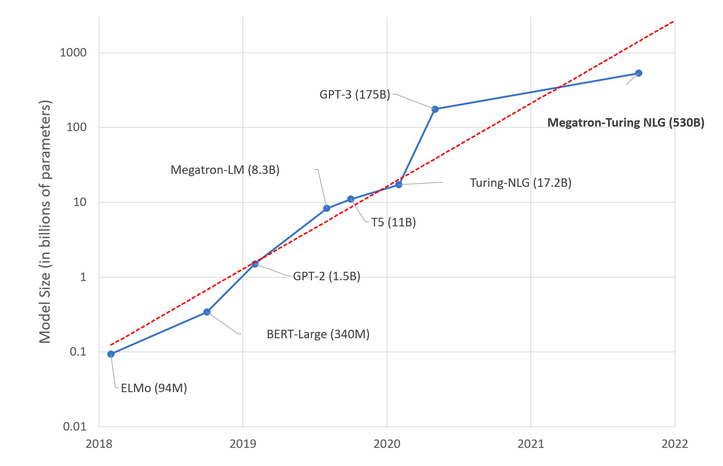
Generative NLP
Most current NLP applications use large language models (LLMs) based on generative NLP
Generative models are pre-trained transformer models that can generate a textual sequence, given a prompt
Prompt engineering refers to fine-tuning generative NLP models to specific application tasks like conversation, summarization, etc.
LLMs and number of parameters used. Source: https://www.microsoft.com/en-us/research/blog/using-deepspeed-and-megatron-to-train-megatron-turing-nlg-530b-the-worlds-largest-and-most-powerful-generative-language-model/

Slide 52
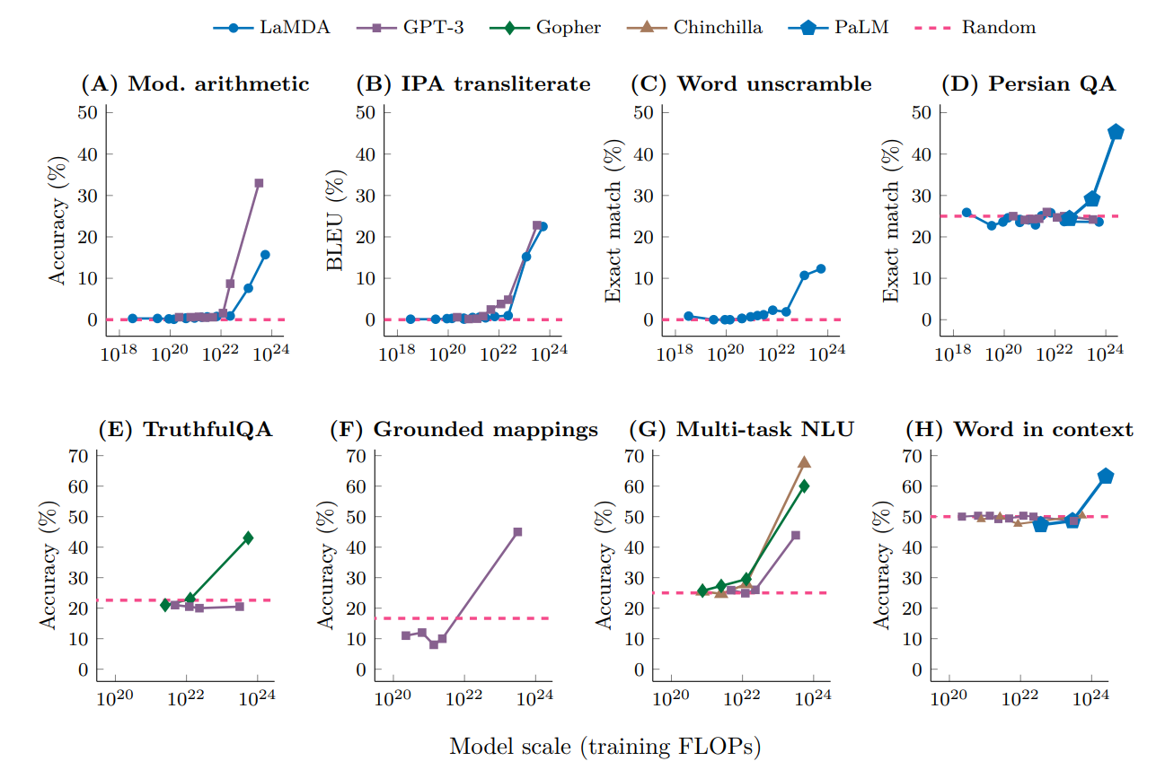
Large Language Models
Large neural networks typically based on MLM transformer architecture with number of parameters in the order of billions or more
Size matters: MLM architectures have been found to be no better than random choice, until, number of parameters cross critical thresholds (typically ~10²⁴ or more parameters)
Very expensive to train from scratch. As of 2020, training a 1.5 billion parameter LLM cost upwards of $1.6 million
Performance of several LLMs benchmarked against random choice, with increase in number of parameters
Jason Wei et al - https://arxiv.org/abs/2206.07682

Slide 53
Fine-tuning LLMs
LLMs are adapted to various downstream NLP tasks by fine-tuning them
Fine-tuning is a form of transfer learning, where existing weights are adjusted for new training data
Subset fine tuning: Freeze the initial layers of the LLM and train only the final few layers on the new dataset
Complete fine tuning: Adjust weights from all layers of the LLM using the new dataset
Examples of fine tuning of GPT-2 for different kinds of example tasks: https://towardsdatascience.com/how-to-fine-tune-gpt-2-for-text-generation-ae2ea53bc272

Slide 54
Tutorial on LLMs

Slide 55
End of Mandate 4

